Slide 1
VCU profile

Slide 2
Profile
Business overview
Product review

Slide 3
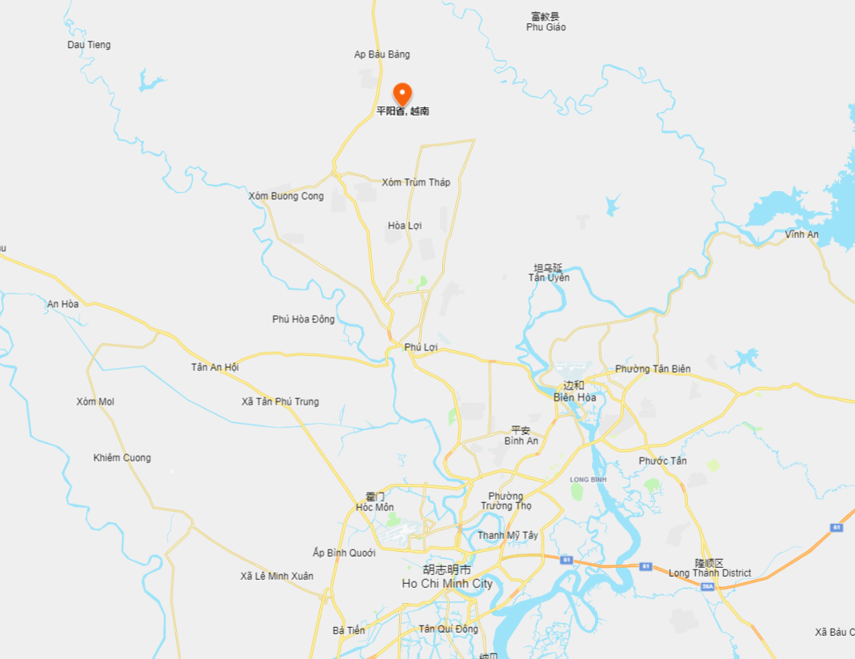
Location
1
Located in Binh Duong Province.
The factory
2
Close to Ho Chi minh City. (About 1 hour by car).
3
With highway and seaport nearby,.
Ho Chi minh City

Slide 4
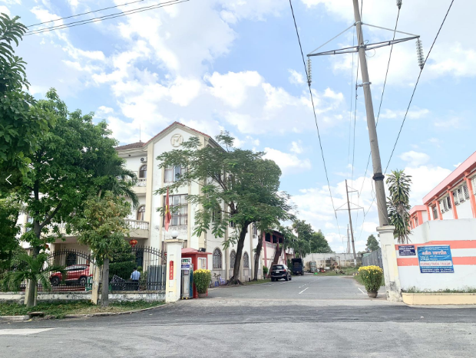
Scale
Our factory occupies an area of 10000m². including 4500m² of the area for production, 1300m² for office, and 4200m² for warehouse.
1
There are 12 production lines and 8 testing lines in total. Total capacity is around 200k pcs per month.
Shipment capacity is 30 containers per month.
2
Vietnam Factory front gate

Slide 5
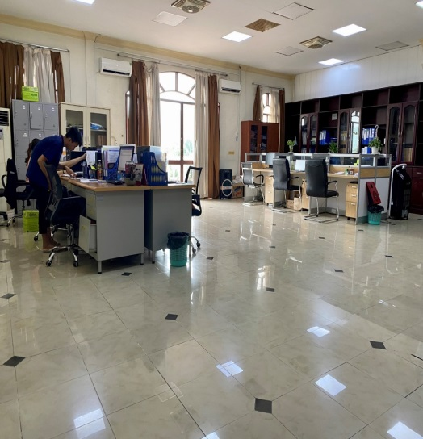
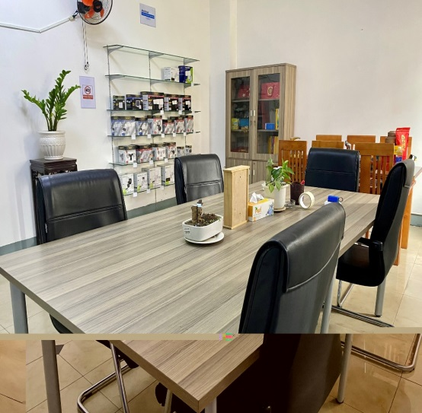
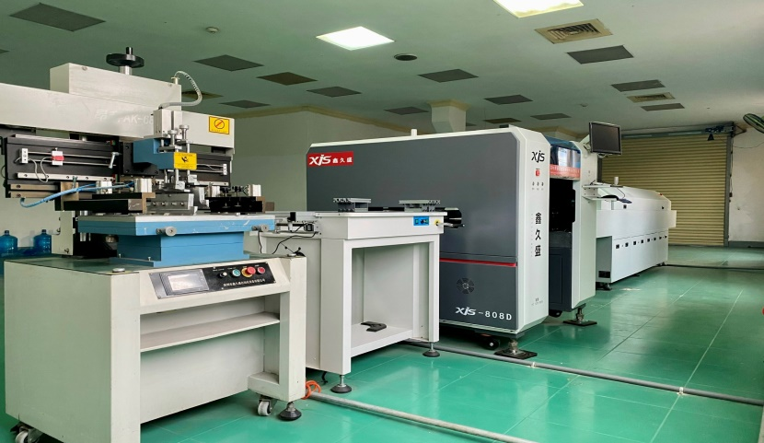
Photo
Office
&
Meeting room
SMT machine

Slide 6
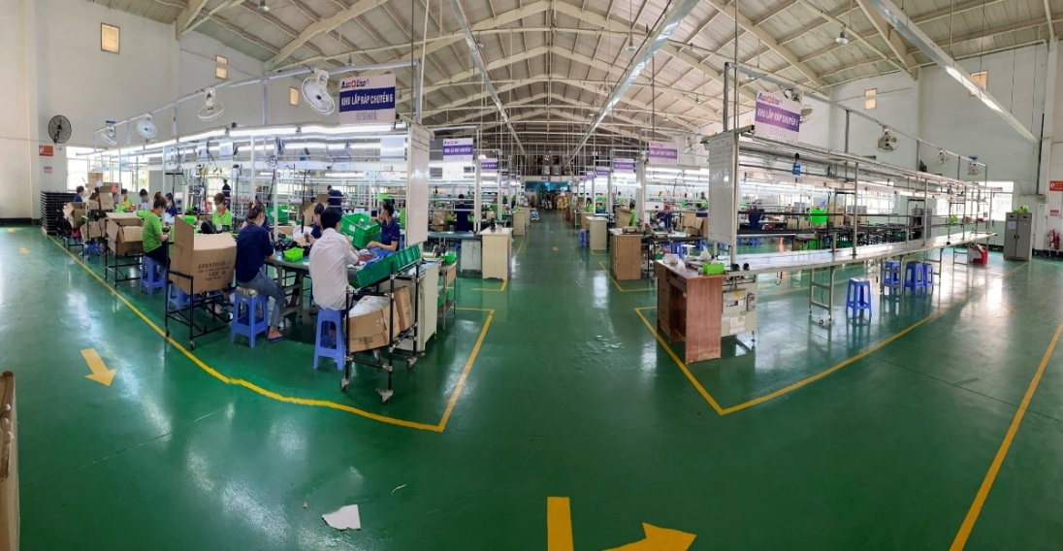
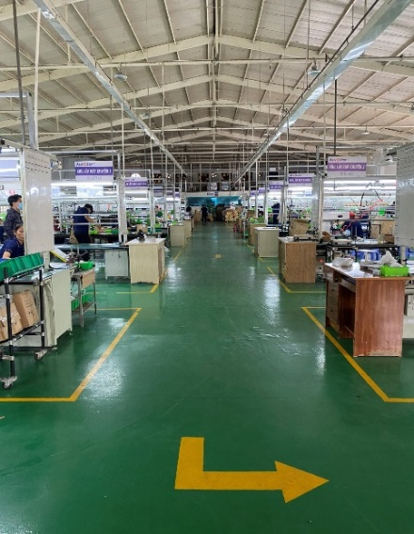
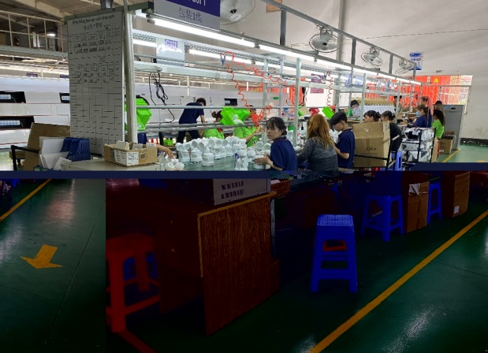
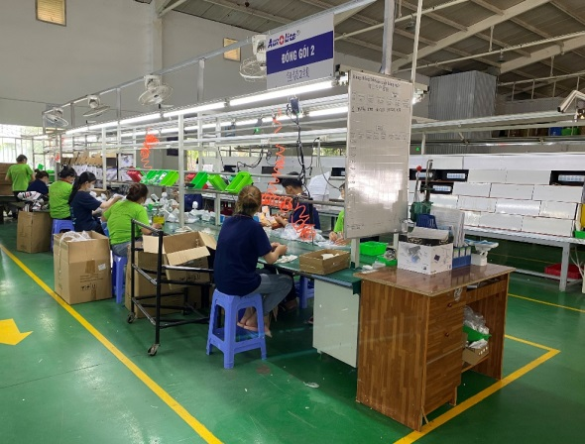
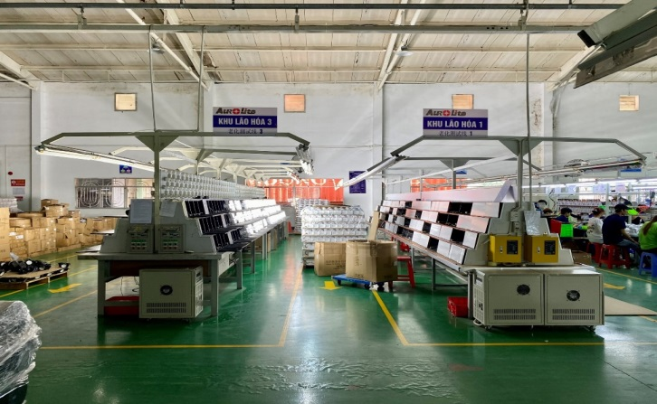
Photo
Assembling line
Packaging and testing line

Slide 7
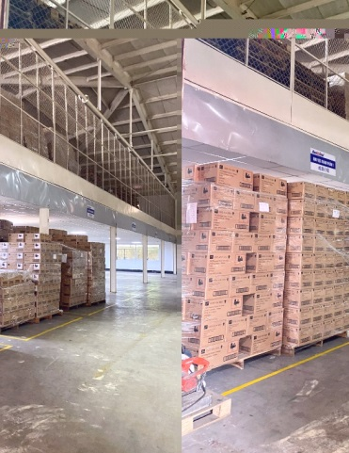
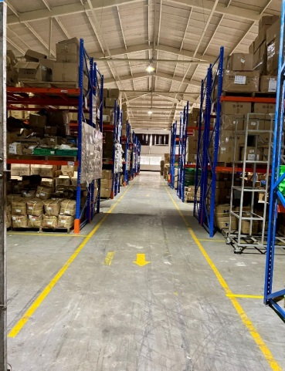
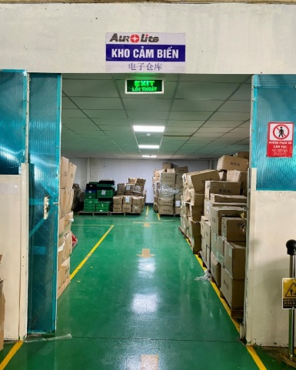
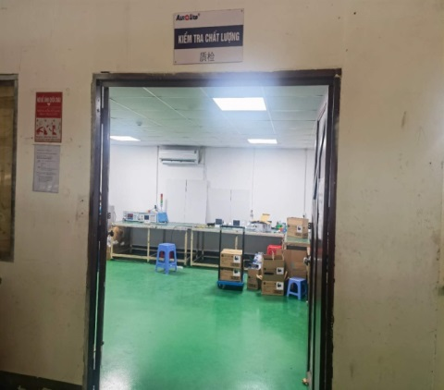
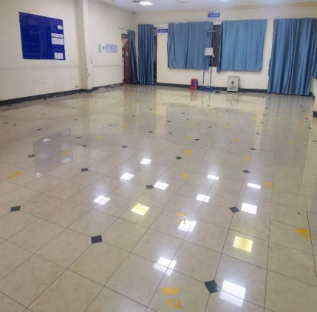
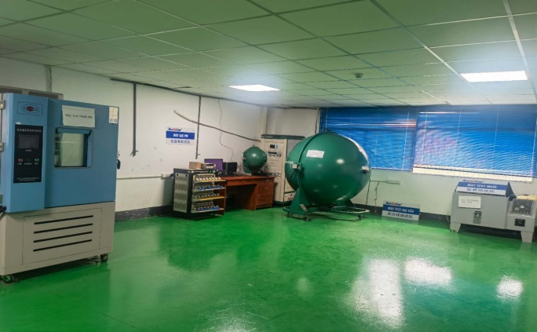
Photo
Warehouse
Inspection area

Slide 8
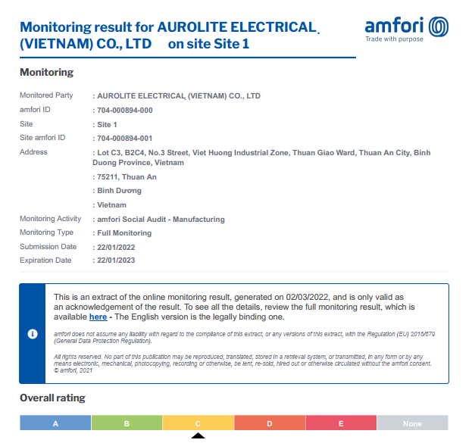
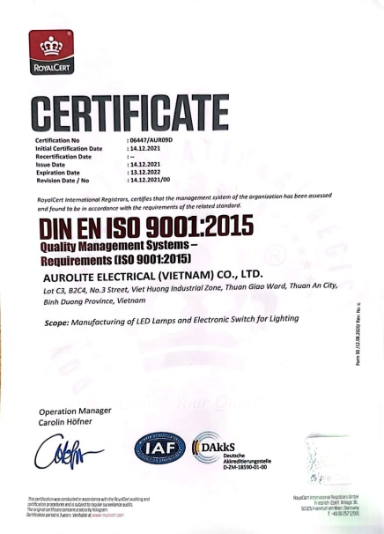
Report
BCSI
ISO9001

Slide 9
Business overview

Slide 10
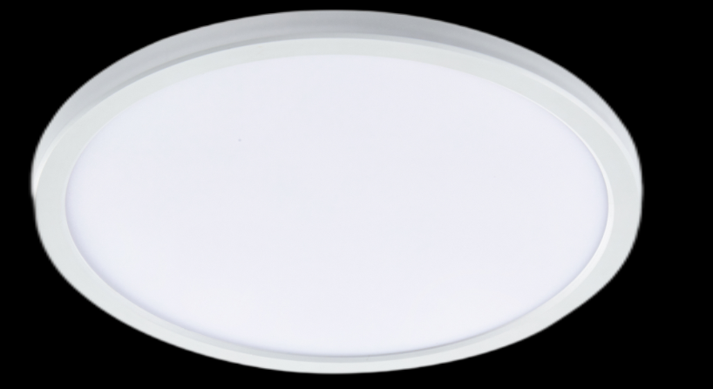
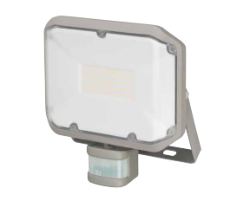
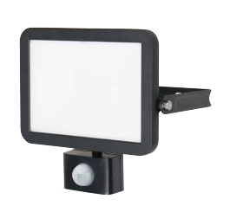
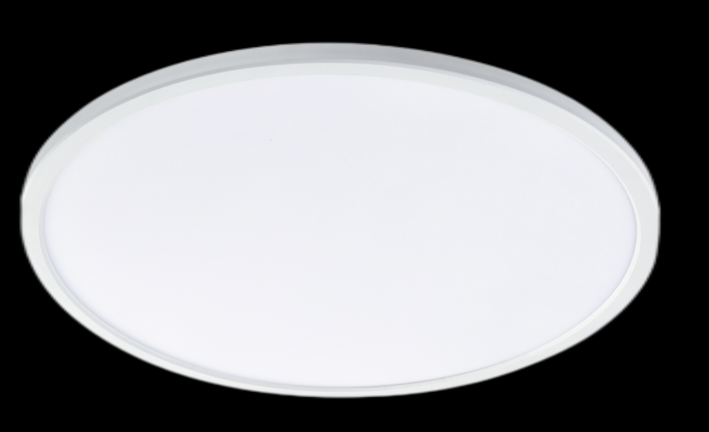
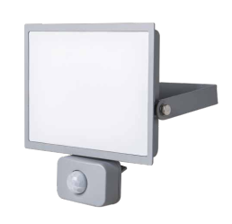
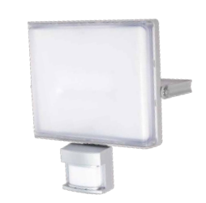
Current product
10-150W available. Many lamp head and sensor head combined
Super thin, the thickness of light is less than 23mm
16W, 24W, 32W, 38W available
Flood light
Ceiling light

Slide 11
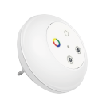
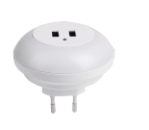
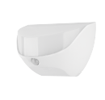
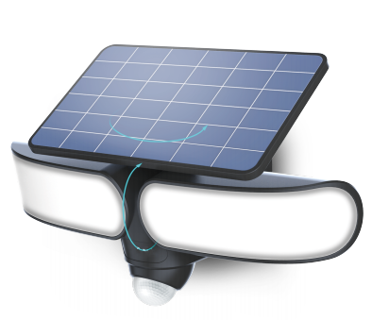
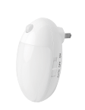
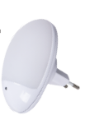
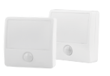
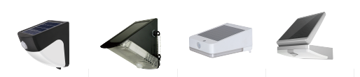
Current product
Night light
Solar light

Slide 12
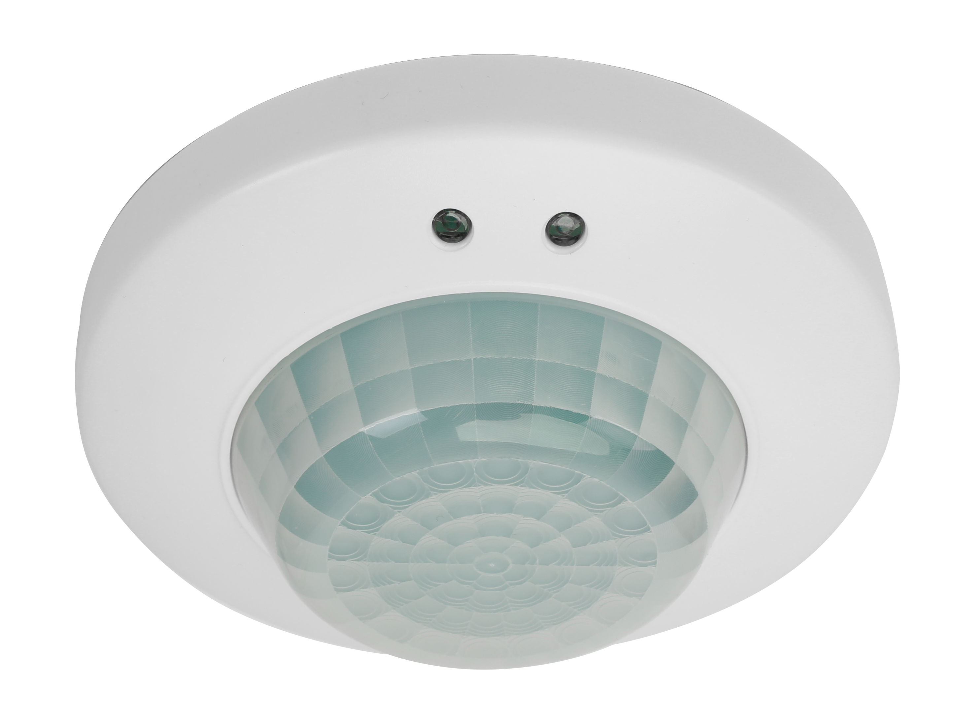
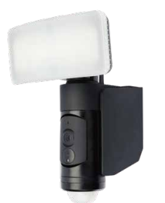
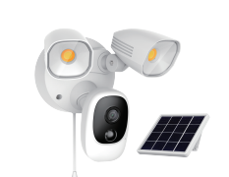
Current product
Smart sensor, connect with other fixture by WIFI, Bluetooth, or ZIGBEE.
Camera light (AC and DC version)
Standalone sensor

Slide 13
Thank You!
Notes:
在“幻灯片放映”模式下，选择箭头访问相应链接。

